Slide 1
Leisure Parks
Josh Fry

Slide 2
Agenda
Workflow
Components
Network Security
Code Overview
Considerations
Future Improvements

Slide 3
Workflow

Slide 4
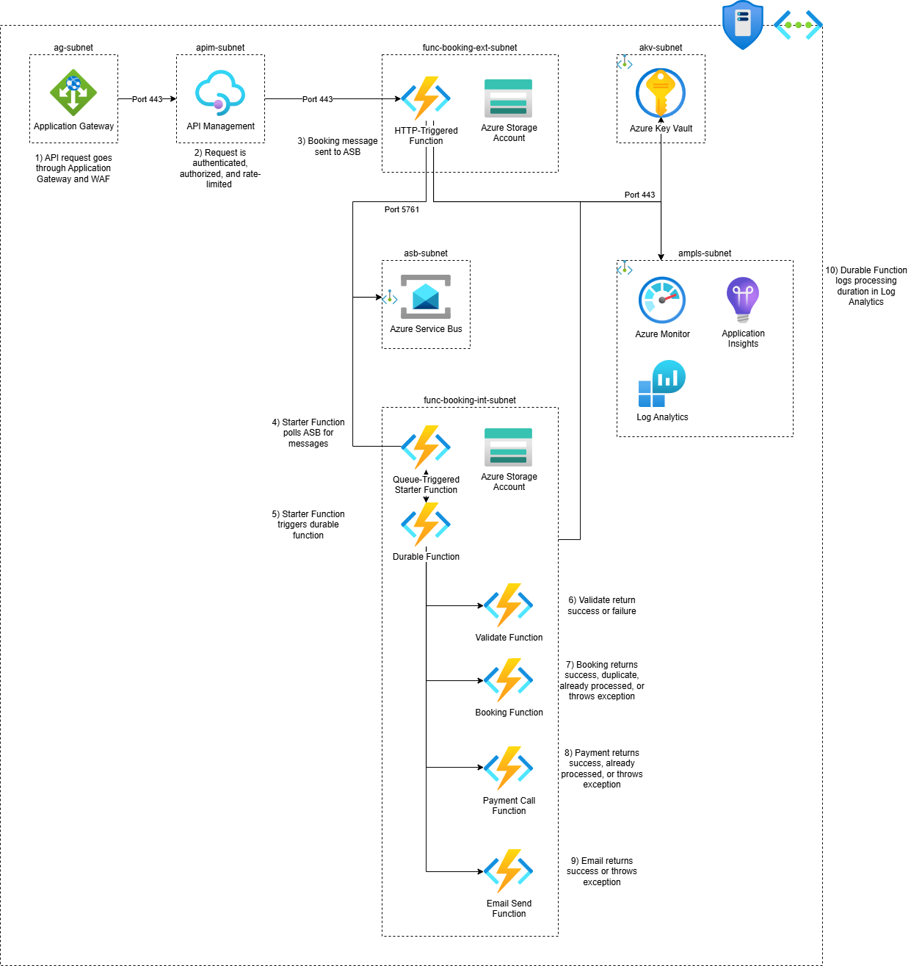

Slide 5
Components

Slide 6

Application Gateway
Security
WAF protects against common exploits
Azure DDoS Protection on the VNet
Ease
Hide the internal APIM endpoints with a custom domain
Backend changes don’t affect API requests

Slide 7
API Management
Security
Authenticate users
Authorize users with Customer role
Restrict origin URLs to our frontend
Features
Rate limit on user id or IP address
Future option to A/B test APIs

Slide 8
Azure Functions
 | Supports Linux Containers | VNet Non-HTTP Event Scaling | Inbound IP restrictions | Inbound Private Endpoints | VNet integration | Outbound IP restrictions
Flex Consumption Plan |  | Y | Y | Y | Y | Y
Consumption Plan |  |  | Y
Premium Plan | Y | Y | Y | Y | Y | Y
Dedicated Plan (App Service Environment) | Y |  | Y | Y | Y (and supports gateway-required VNet integration) | Y
Container Apps | Y |  |  |  | Y | Y
Flex Consumption Plan
Pay-as-you-go for when we don’t receive many bookings
Supports VNet integrations to talk to ASB, AKV, AI with a Private Endpoint
Each function is independently scalable and/or always ready

Slide 9
Azure Service Bus
Producer-Consumer Pattern
Separation of Concerns
Background Processing
Immediate Response
Retry Pattern
Reliability
Robust

Slide 10
Durable Functions
Retry Pattern
Retry individual activity functions
Reusability
Activity functions can re-used in other orchestrations e.g., email or taking payment.

Slide 11
Application Insights
Stores OpenTelemetry traces, metrics, and logs.
Gives us the ability to trace a HTTP request, through the service bus and retries, down to where an email is sent.
Can optionally send logs and metrics from AG, APIM, ASB, and AKV resources.

Slide 12
Azure Key Vault
Security
Store the instrumentation key to Application Insights in one place.

Slide 13
Network Security

Slide 14
Subnets
Microsoft recommends that AG, APIM, and Functions are deployed into their own subnets.
ASB and AKV cannot be deployed into a subnet and instead need to have a Private Endpoint. This enables data to and from to go over the Azure backbone.
AI is connected by using an Azure Monitor Private Link Scope (AMPLS).

Slide 15
Network Security Groups
NSGs can be managed either by:
IP of the resource
An IP range e.g., the subnet’s block
Application Security Groups (ASGs) assigned to resources
Service Tags
I would use ASGs as they aren’t affected by network changes and are specific to designated resources.

Slide 16
ag-subnet
Inbound
Allow port 443 (HTTPS) from Internet
Outbound
Allow port 443 to
apim-subnet

Slide 17
apim-subnet
Inbound
Allow port 443 from
ag-subnet
Outbound
Allow port 443 to
apim-subnet

Slide 18
func-booking-ext-subnet
func-booking-int-subnet
Inbound
Allow port 443 from
apim-subnet
Outbound
Allow port 443 to
akv-subnet
ampls-subnet
Allow 5761 (AMQP TLS) to
asb-subnet

Slide 19
asb-subnet
Inbound
Allow port 5761 from
func-booking-ext-subnet
func-booking-int-subnet
Note
AMQP-over-Websockets port 443 has a small overhead compared to 5761.
5762 is AMQP unencrypted.

Slide 20
akv-subnet
ampls-subnet
Inbound
Allow port 443 from
func-booking-ext-subnet
func-booking-int-subnet

Slide 21
Code Overview

Slide 22
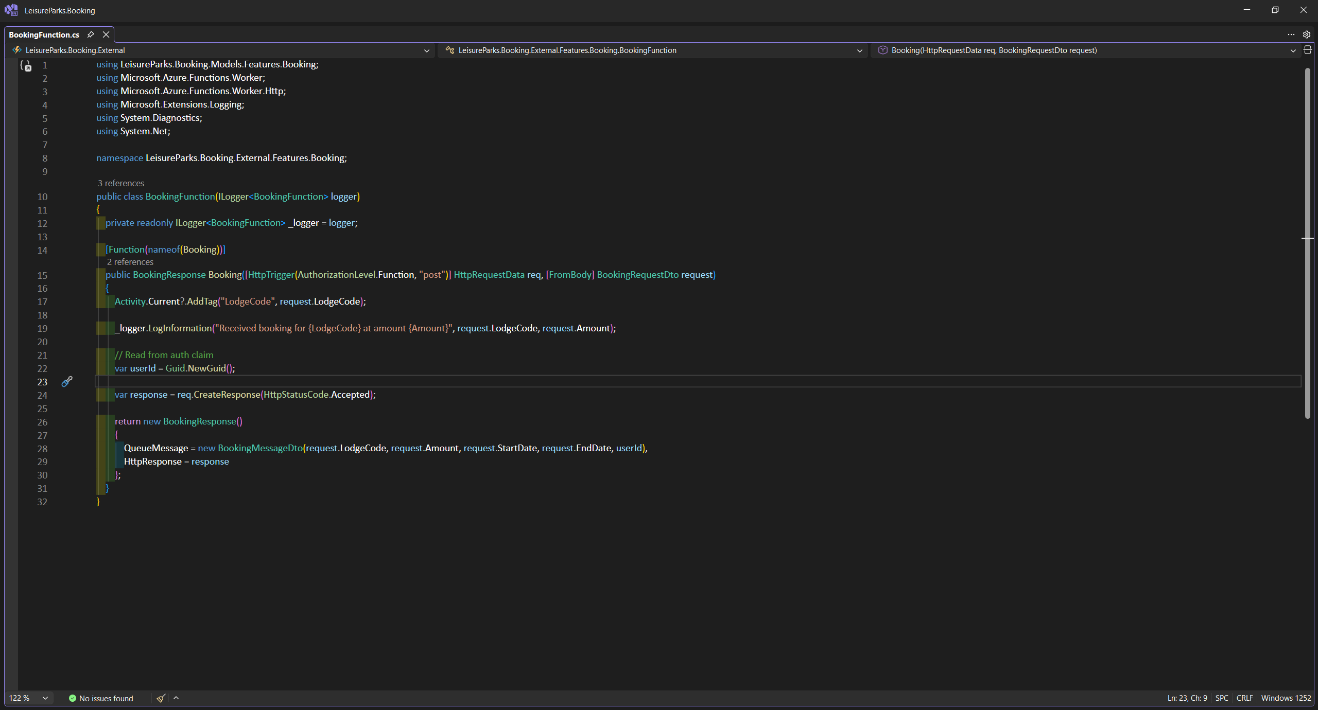

Slide 23
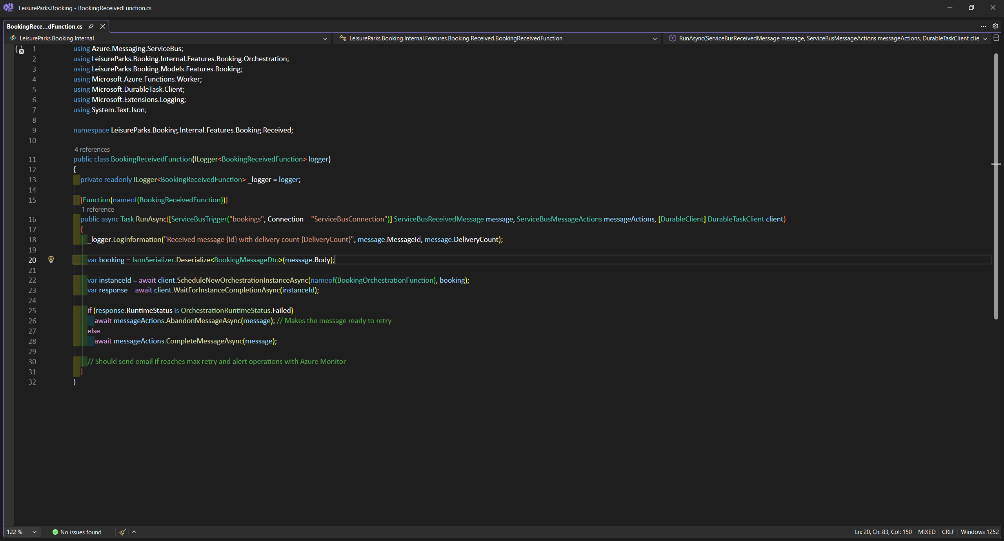

Slide 24
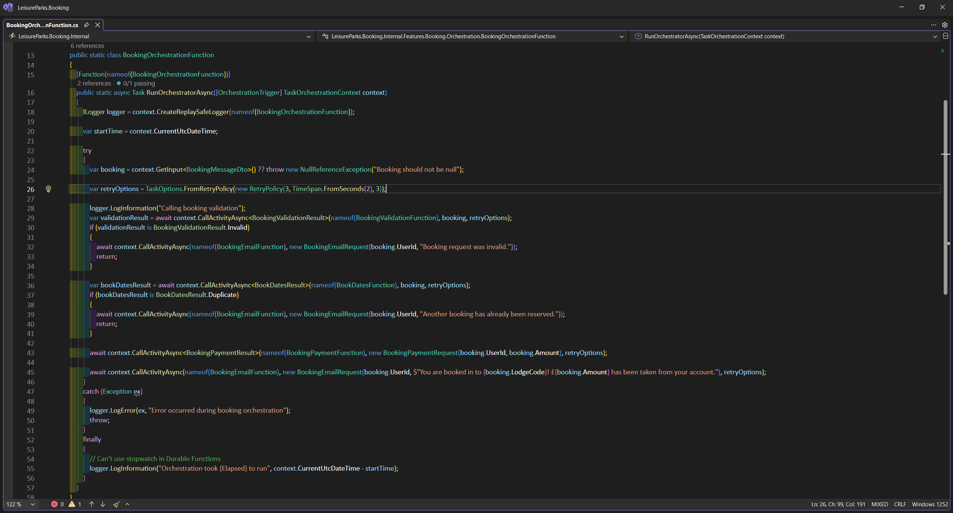

Slide 26
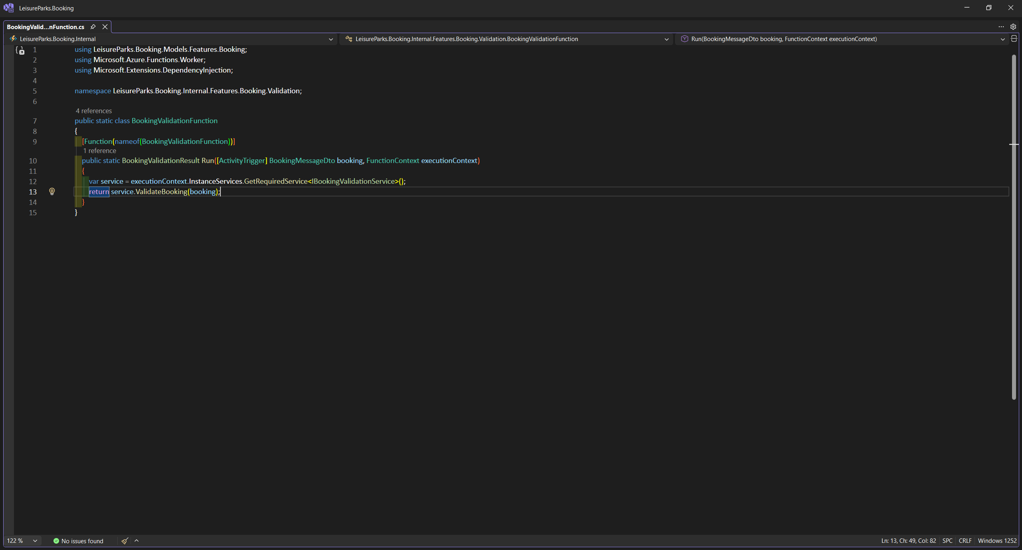

Slide 27
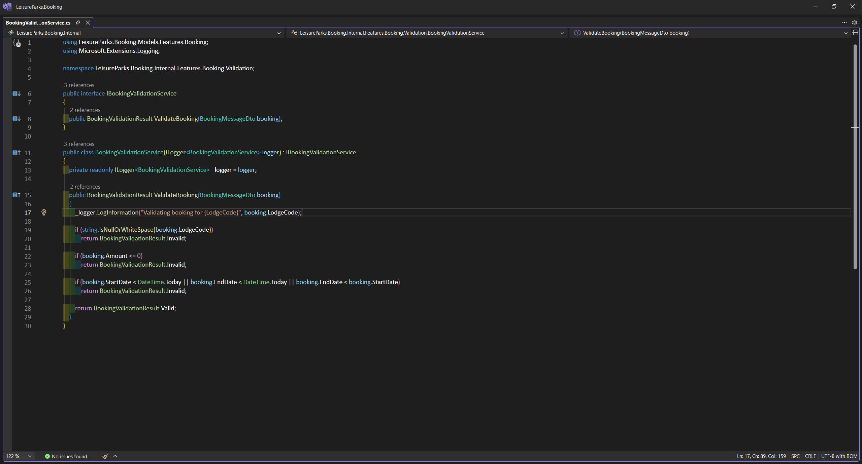

Slide 28
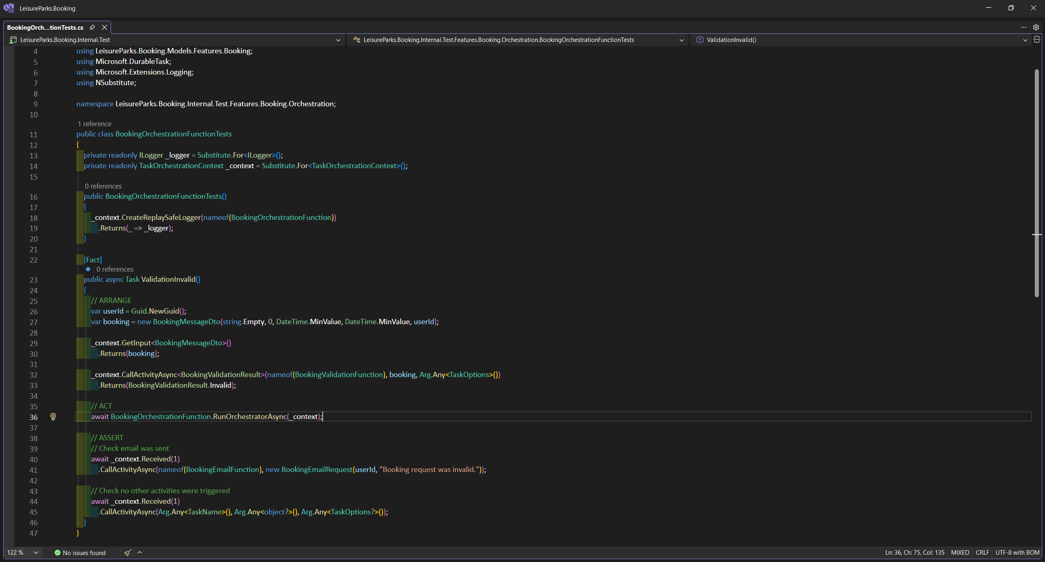

Slide 29
Considerations

Slide 30
.NET Version
Performance
In most benchmarks, .NET 9 is faster
Security
The support for .NET 8 LTS and the.NET 9 STS end at the same time.

Slide 31
Application Gateway
Security
We could use APIM without AG but would lose the WAF.
Scalability
We could use Azure Front Door in the future for a multi-region WAF.

Slide 32
Early Validation
We could do basic validation e.g., on the dates of the booking within the HTTP function.
This would not have a large overhead and prevent bad requests going through to the ASB.
This would give users an immediate result if we know it’s a bad request.

Slide 33
Retry Policies
By using Durable Functions, we can’t use Polly to add jitter or a circuit breaker to the backoff/retry.
Durable functions can prevent a retry based on an exception, but this wouldn’t open the circuit for other requests.

Slide 34
Message Retry
Because messages can be retried, the booking and payment activity functions need to handle if it has already been processed.
There is also a case where after so many payment failures, the orchestration and message could dead-letter - leaving the booking still active but unpaid.
A compensating transaction could be implemented to undo the booking, and dead-letter alerts.

Slide 35
Future Improvements
Better monitoring with Azure Monitor alerts and health checks
Infrastructure-as-Code that is controlled by a CI/CD pipeline
Higher unit test coverage
Integration tests to cover the entire workflow from the frontend site

